Slide 1
Hiring Process Analytics (statistics)
Shilpi Soni

Slide 2

Project Description
Analyze the company's hiring process data and draw meaningful insights from it.
The hiring process is a crucial function of any company, and understanding trends such as the number of rejections, interviews, job types, and vacancies can provide valuable insights for the hiring department.
The goal of this project is to use knowledge of statistics and Excel to draw meaningful conclusions about the company's hiring process.

Slide 3

Approach
Handling Missing Data and remove duplicate:The data would need to be cleaned to remove any duplicate (or) irrelevant entries and ensure that the data is properly formatted on the analysis.
Outlier Detection & Removal:Check and identify the outliers.
Data Summary: Now extract the useful insights using statistical analysis and visualize the insights using data visualization methods

Slide 4


Tech-Stack Used
Microsoft excel 2019
The purpose of using Excel:
Microsoft Excel is one of the most popular applications for data analysis.
Equipped with built-in pivot tables, they are without a doubt the most sought-after analytic tool available.
It is an all-in-one data-management software that allows you to easily import, explore, clean, analyze, and visualize your data.

Slide 5
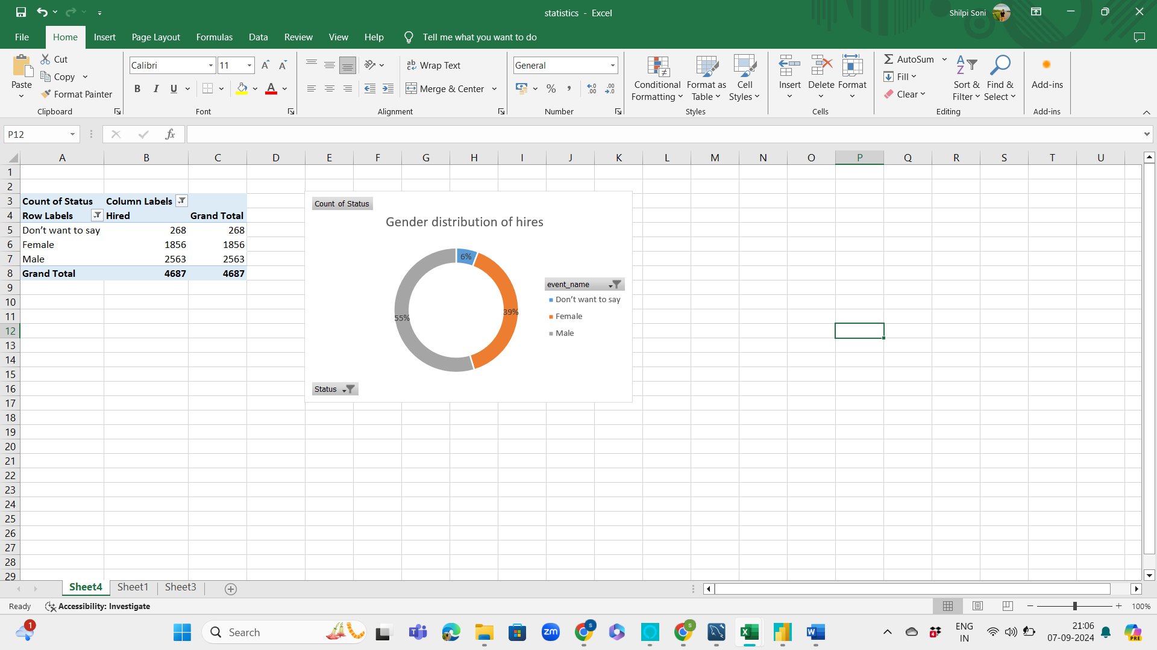
The hiring process involves bringing new individuals into the organization for various roles.
HIRING ANALYSIS
Task 1: Determine the gender distribution of hires. How many males and females have been hired by the company?

Slide 6
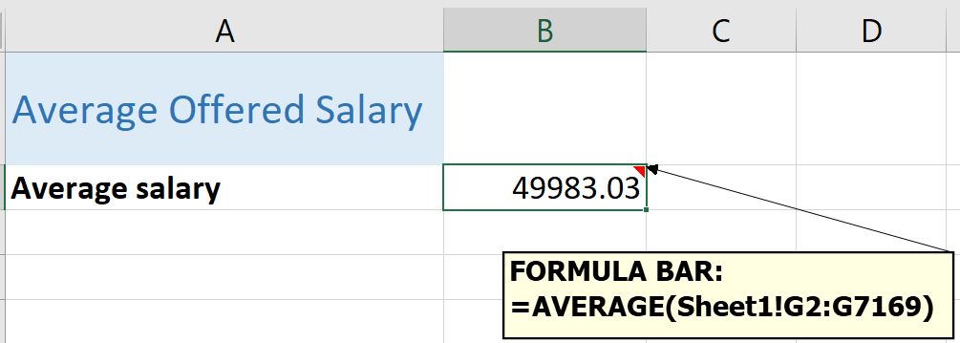

The average salary is calculated by adding up the salaries of a group of employees and then dividing the total by the number of employees.
SALARY ANALYSIS
Task 2: What is the average salary offered by this company? Use Excel functions to calculate this.

Slide 7
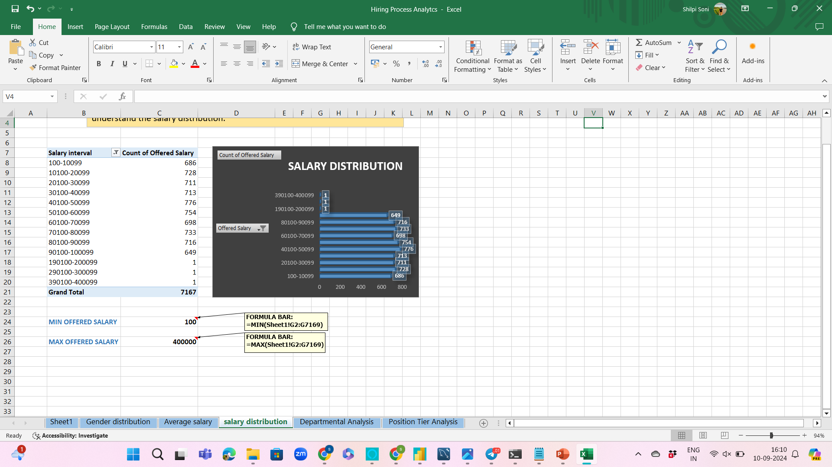
Salary Distribution
Class intervals represent ranges of values, in this case, salary ranges. The class interval is the difference between the upper and lower limits of a class.
Task 3: Create class intervals for the salaries in the company. This will help you understand the salary distribution.

Slide 8

Salary Distribution

Slide 9
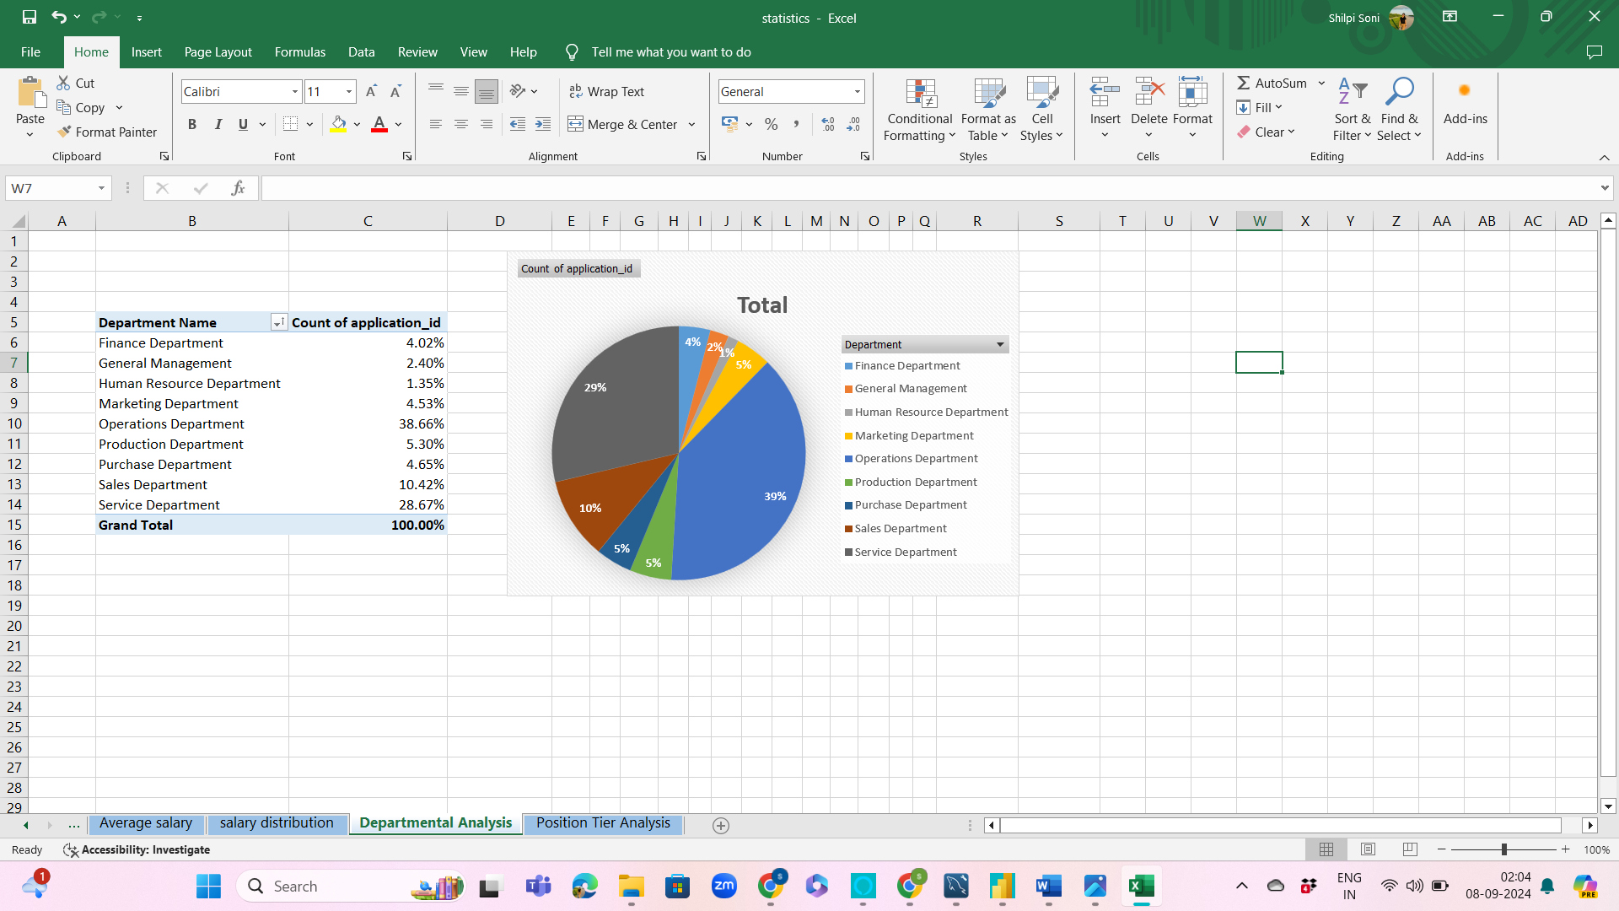
Departmental Analysis
Visualizing data through charts and plots is a crucial part of data analysis.
Task 4: Use a pie chart, bar graph, or any other suitable visualization to show the proportion of people working in different departments.

Slide 10
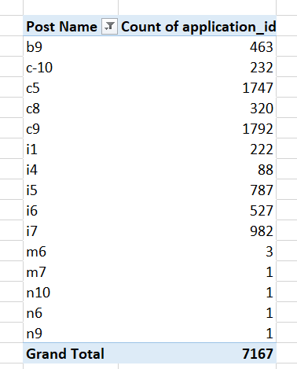
Position Tier Analysis
Different positions within a company often have different tiers or levels.
TASK 5: Use a chart or graph to represent the different position tiers within the company. This will help you understand the distribution of positions across different tiers.

Slide 11
Position Tier Analysis

Slide 12
Thank you

